Slide 1
Personal Activity Recommendation System based on Real-Time Streaming Weather Data
Prepared by: Mosab Adwan & Waleed AbuZaina
Submitted to : Dr.Hamed Abdalhaq

Slide 2

Outline
Problem Statement
System Overview
Pipeline Diagram
Data Collection with IoT Sensors
Data Streaming with Kafka
ML Recommendation System
Recommendation System Threshold
Web Application

Slide 3
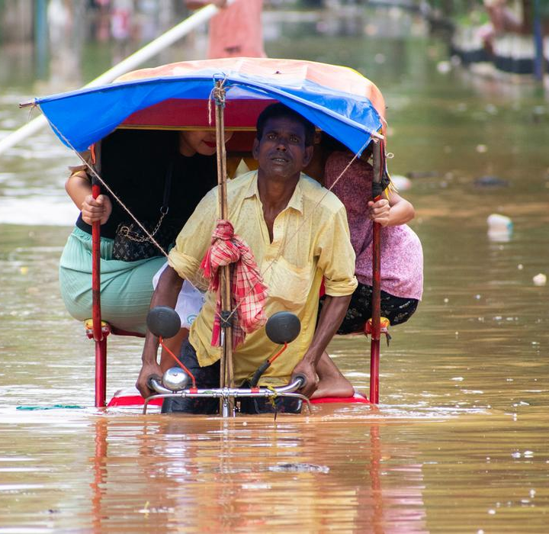
Problem Statement
Challenges in Daily Activity Planning:
Unpredictable Weather:
Rapid weather changes disrupt outdoor activities.
Limited real-time access to tailored weather data.
Lack of Personalization:
Generic weather forecasts fail to cater to individual preferences.
Health and Safety Concerns:
Engaging in activities unsuitable for current conditions can lead to discomfort or risks.

Slide 4
System Overview
Objective:
To provide personalized activity recommendations based on real-time weather data.
Core Components:
Data Collection (IoT)
Real-Time Streaming (Kafka)
AI-Based Recommendations
User Interaction (Web App)

Slide 5
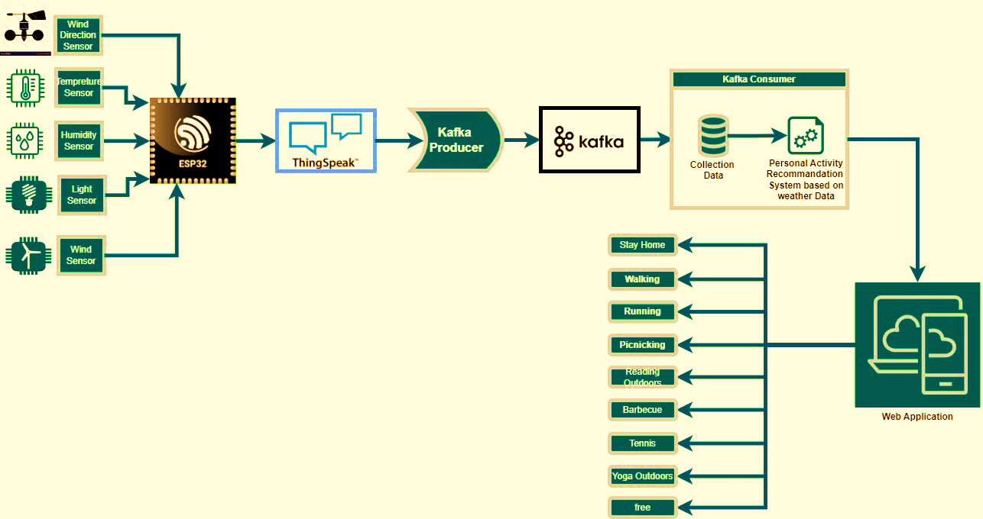
Pipeline Diagram

Slide 6
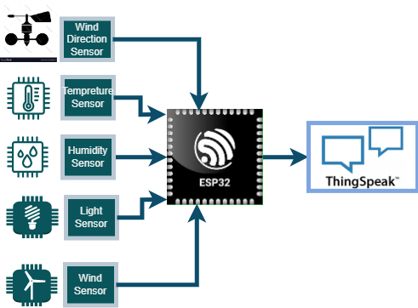
Data Collection with IoT Sensors
Innovative Features:
Sensors Used:
Temperature
Humidity
Wind Speed/Direction
Light Intensity
Processing Unit:
ESP32 microcontroller for low-cost and efficient data handling.
Data Integration Platform:
ThingSpeak for real-time weather data collection and storage.

Slide 7
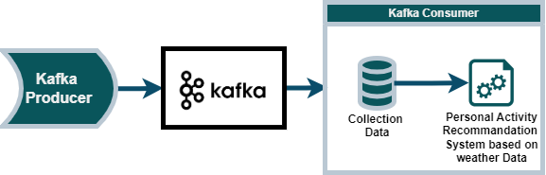
Data Streaming with Kafka
Producer:
Streams data from ThingSpeak into Kafka topics.
Anomaly Detection:
Identify unusual weather patterns for proactive recommendations.
Scalability:
Kafka ensures fault-tolerant and high-throughput streaming.

Slide 8
ML Recommendation System
Machine Learning Algorithms:
Model trained on historical weather and activity preference data.
Adaptive learning to refine recommendations based on user feedback.
Example Predictions:
Sunny day: Outdoor activities like running, cycling.
Light Rainy day: Outdoor activities like yoga, reading.

Slide 9
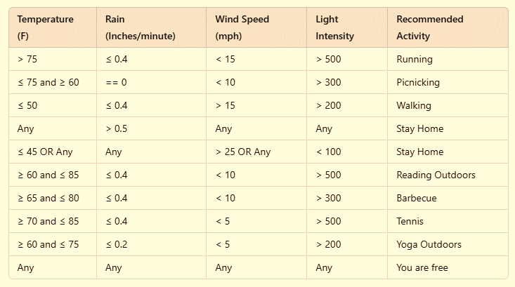
Recommendation System Threshold

Slide 10
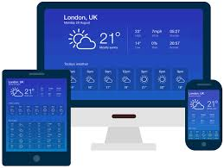
Web Application
User Dashboard:
Personalized activity recommendations updated in real time.
Interactive Design:
Easy-to-use interface for browsing and selecting activities.

Slide 12
Future Work
Alerts for sudden weather changes with updated recommendations.
Enhance the Recommendation system conditions “Threshold”.

